Slide 1
Network intrusion detection system using machine learning
Imran
(Student ID: AD20196804)

Slide 2
Table of contents
Introduction
Implementation
Performance analysis
conclusion

Slide 3
Introduction
Internet has positively changed social, political and economic structures and in many ways obviating geographical boundaries.
The enormous contributions of Internet to business transactions coupled with its ease of use has resulted in increased number of internet users and consequently, intruders.
It is crucial to safeguard computer resources with the aid of Intrusion Detection Systems (IDS) in addition to Intrusion Prevention Systems.
In recent times, enormous network traffic generated in terabytes within couples of seconds are difficult to analyze with the traditional rule-based approach; hence, researchers have to subject data mining techniques to intrusion detection with emphasis on intrusion detection accuracy; relevant feature selection leads to faster and enhanced accurate detection rate.
Therefore In this project machine learning based IDS are presented.
Empirical results from the UNSW-NB15 intrusion detection dataset on thirty selected attributes is a highly ranked decision, thus, the IDS is suitable for real time intrusion detection.

Slide 4
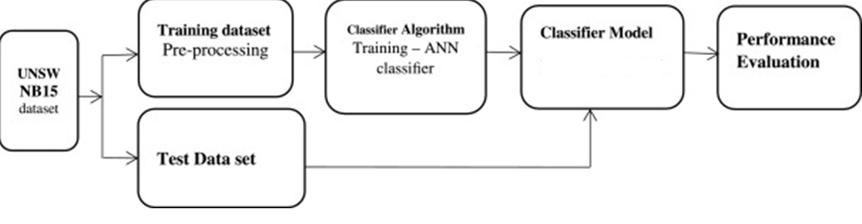
Anomaly classification methodology
This is a Classification problem where we want to detect whether there is an attack or not.
We will use simple Logistic Regression.
K-Nearest Neighbour (Lazy Algorithm)
Decision Trees
Random Forest (gini)
Random Forest (Entropy or Information-gain)

Slide 5
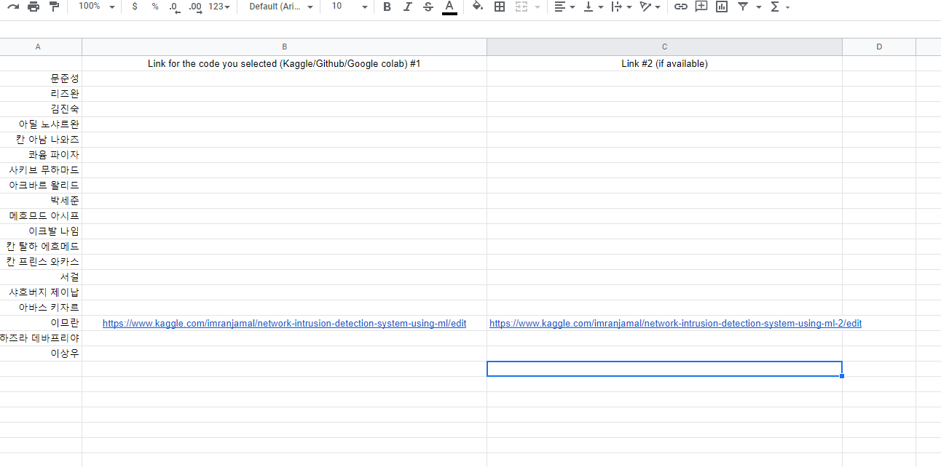
Links to code at my Kaggle account
https://www.kaggle.com/imranjamal/network-intrusion-detection-system-using-ml/edit
https://www.kaggle.com/imranjamal/network-intrusion-detection-system-using-ml-2/edit

Slide 6
Modelling Intrusion Detection
Step 1: Data preprocessing:
All features are made numerical using one-Hot-encoding. The features are scaled to avoid features with large values that may weigh too much in the results.
Step 2: Feature Selection:
Eliminate redundant and irrelevant data by selecting a subset of relevant features that fully represents the given problem.
Univariate feature selection with ANOVA F-test. This analyzes each feature individually to determine the strength of the relationship between the feature and labels.
Using Second Percentile method (sklearn. feature selection) to select features based on percentile of the highest scores. When this subset is found: Recursive Feature Elimination (RFE) is applied.
Step 3: Build the model:
Step 4: Prediction & Evaluation (validation):
Using the test data to make predictions of the model. Multiple scores are considered such as: accuracy score, recall, f-measure, confusion matrix. perform a 10-fold cross-validation.

Slide 7
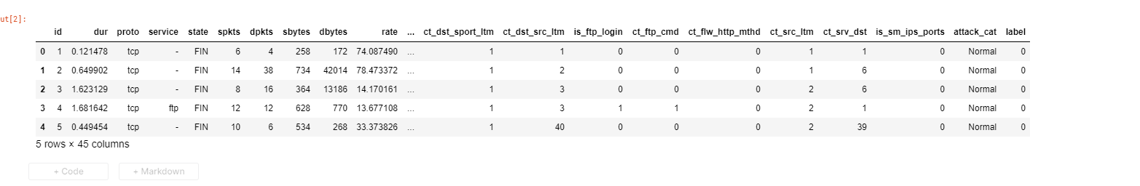
Dataset Features
The UNSW-NB15 dataset, uniquely captured and developed for training an IDS, is used in this study as the benchmark dataset, consisting of 45 features and 9 types of attacks for 82,332 records for the training set.
The UNSW-NB15 intrusion detection dataset created by Cyber Range Lab of the Australian Centre for Cyber Security (ACCS) is sufficient for the study requirement [13].
The 9 types of attacks contained in the UNSW-NB15 dataset namely, Fuzzers, Analysis, Backdoors, DoS, Exploits, Generic, Reconnaissance, Shellcode, and Worms, contains 45 distinct features.
These features can be nominal and non-nominal values such as float, binary, timestamp and integer.

Slide 8
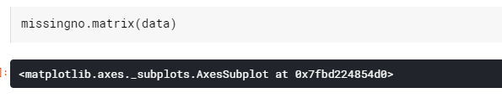
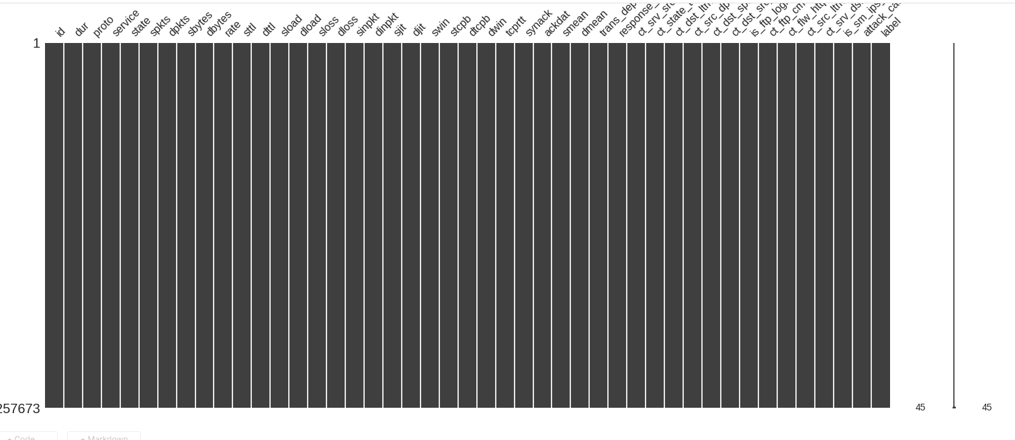
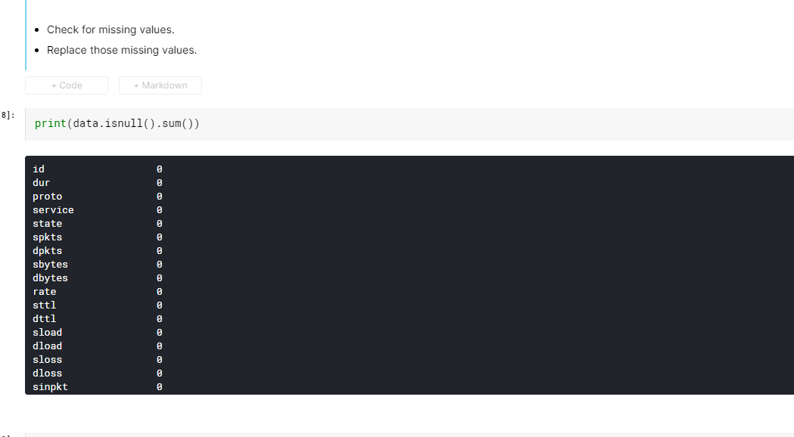
Data Preprocessing and Features selection
Missing values are the Achilles’s heel for machine learning model.
If not handled properly, the entire analysis will be futile and provide misleading results which could potentially harm the business stakeholders.

Slide 9
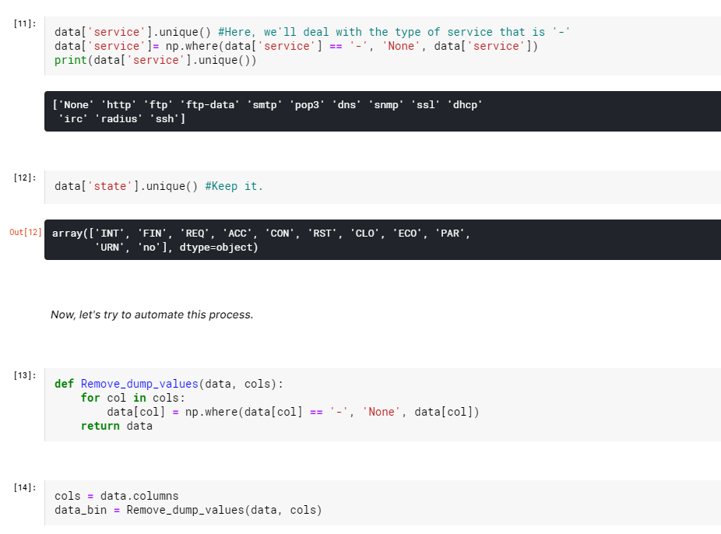
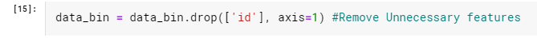
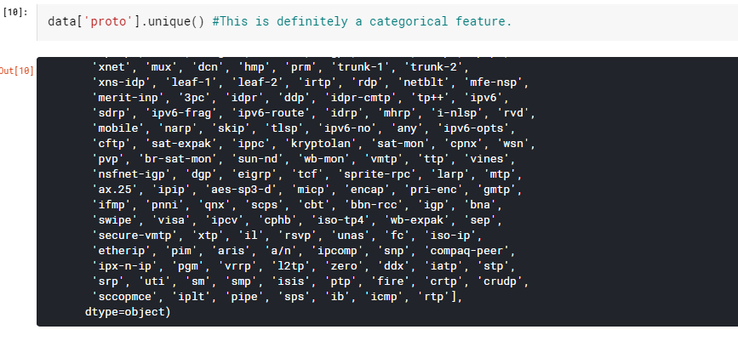
Data Preprocessing and Features selection
Data is clean. Data still needs further processing in terms of One-hot-encoding for categorical data. E.g.: 'service' consists of different types, we have ftp, http, and '-' denoting (not available or None),
So we will need to treat it as a missing value as we will change it from '-' to 'None' instead of dropping the whole column.
Removing unnecessary features like 'id'..

Slide 10
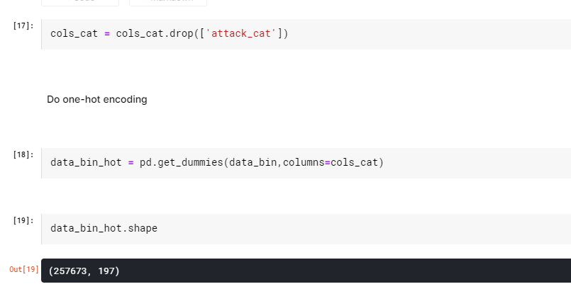
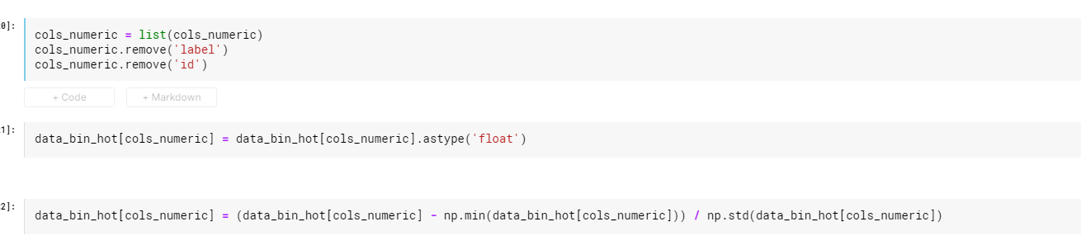
Data preprocessing-One-Hot-Encoding
One-Hot-Encoding is used to to transform all categorical features into binary features.
Requirement for One-Hot-encoding:
"The input to this transformer should be a matrix of integers, denoting the values taken on by categorical (discrete) features.
The output will be a sparse matrix where each column corresponds to one possible value of one feature. It is assumed that input features take on values in the range [0, n_values)."
Therefore the features first need to be transformed with LabelEncoder, to transform every category to a number.

Slide 11
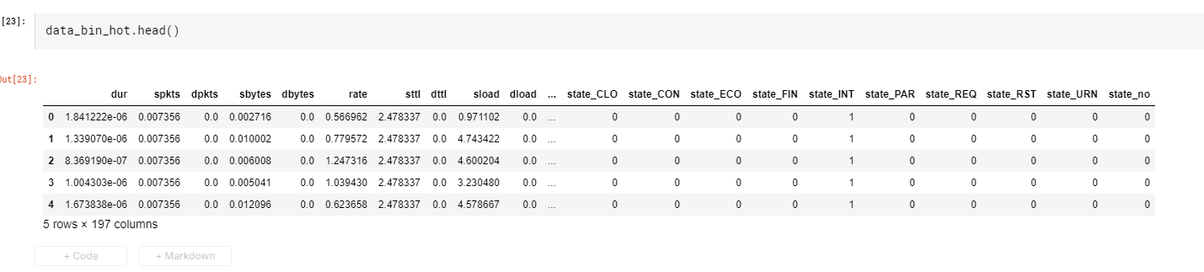
Data preprocessing-One-Hot-Encoding
One-Hot-Encoding is used to to transform all categorical features into binary features.
Requirement for One-Hot-encoding:
"The input to this transformer should be a matrix of integers, denoting the values taken on by categorical (discrete) features.
The output will be a sparse matrix where each column corresponds to one possible value of one feature. It is assumed that input features take on values in the range [0, n_values)."
Therefore the features first need to be transformed with LabelEncoder, to transform every category to a number.

Slide 12
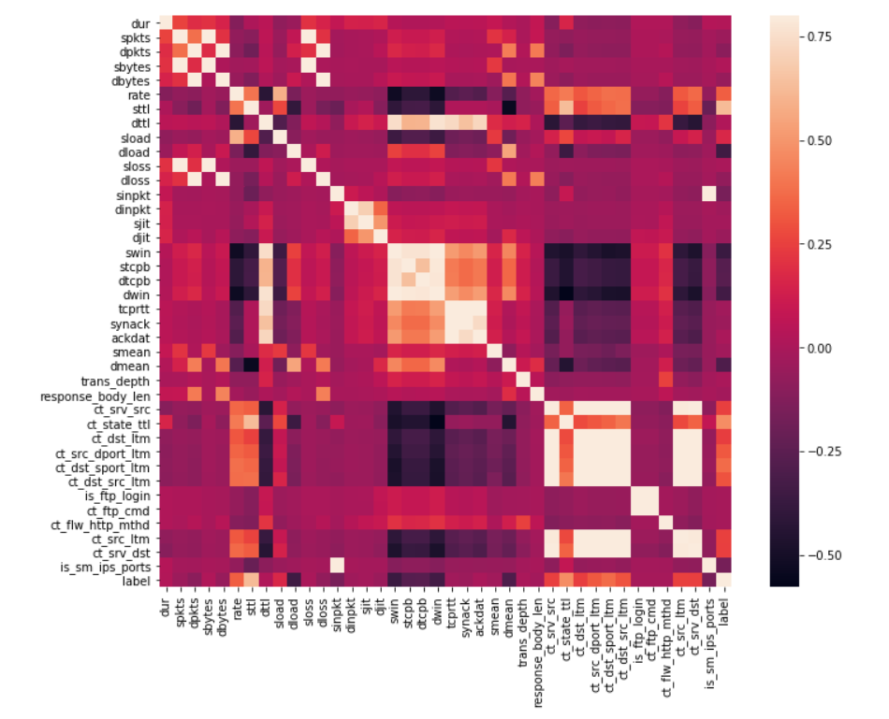
Correlation Analysis
Machine Learning models are as good or as bad as the data you have. That’s why data scientists can spend hours on pre-processing and cleansing the data.
They select only the features that would contribute most to the quality of the resulting model. This process is called “Feature Selection”.
Feature Selection is the process of selecting the attributes that can make the predicted variable more accurate or eliminating those attributes that are irrelevant and can decrease the model accuracy and quality.
Data Correlation: Is a way to understand the relationship between multiple variables and attributes in your dataset.
Using Correlation, you can get some insights such as:
One or multiple attributes depend on another attribute or a cause for another attribute.
One or multiple attributes are associated with other attributes.
Correlation can help in predicting one attribute from another (Great way to impute missing values).
Correlation can (sometimes) indicate the presence of a causal relationship.
Correlation is used as a basic quantity for many modelling techniques.

Slide 13
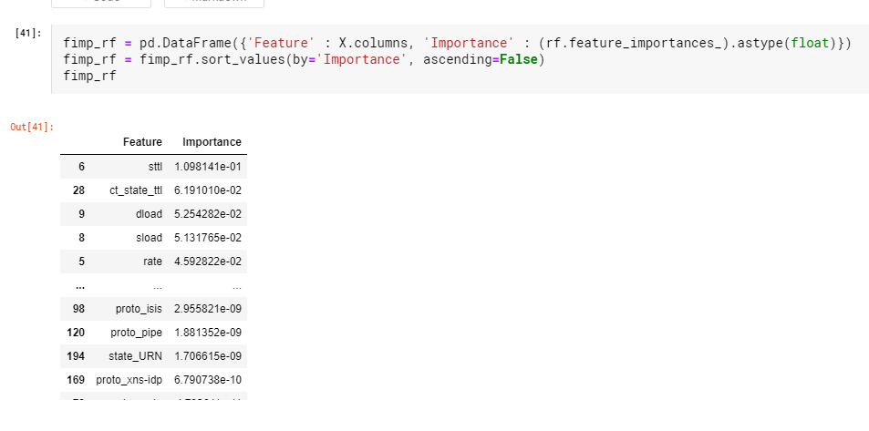
Feature Importance
You can get the feature importance of each feature of your dataset by using the feature importance property of the model.
Feature importance gives you a score for each feature of your data, the higher the score more important or relevant is the feature towards your output variable.
Feature importance is an inbuilt class that comes with Tree Based Classifiers, we will be using Extra Tree Classifier for extracting the top 10 features for the dataset.

Slide 14
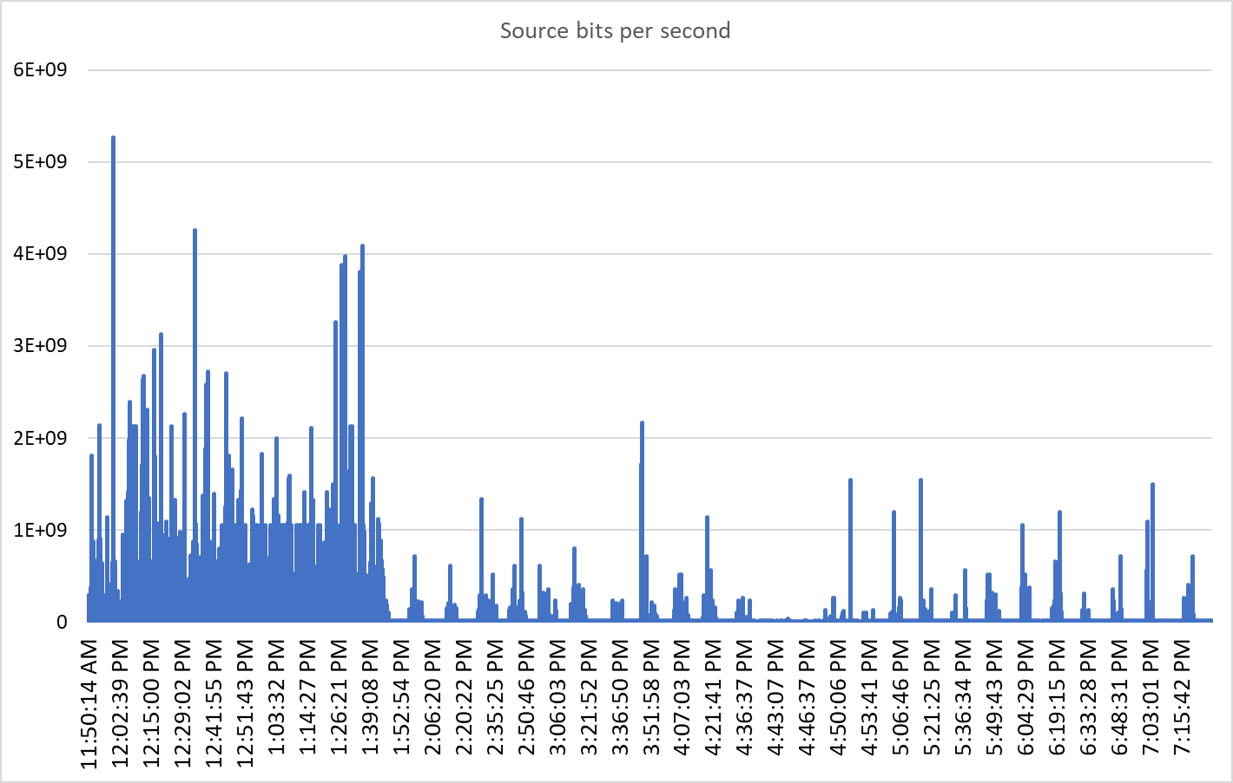
Data Visualization-Sload Feature
Sload means Source bits per seconds.
As the term implies, the speed in bps is equal to the number of bits transmitted or received each second.
X-axis of the chart represents time duration of the transactions.
Y-Axis represents Source bits per seconds
Source bits per second
Time

Slide 15
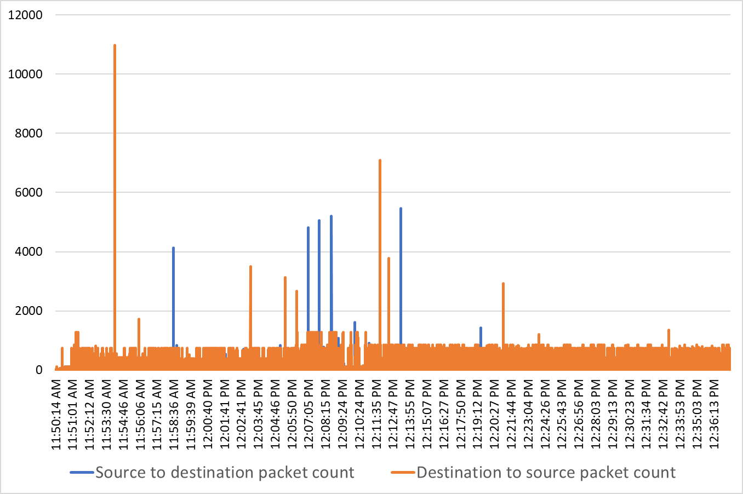
Data Visualization-Spkts and Dpkts
Spkts and Dpkts contains integer values.
SPKTS stands for Source to destination packet count whereas Dpkts stands for Destination to source packet count.
X-axis represents time of the request.
Y-Axis represents packet count.
SPKTS and Dpkts is visualized using line chart.
Packet Count
Time

Slide 16
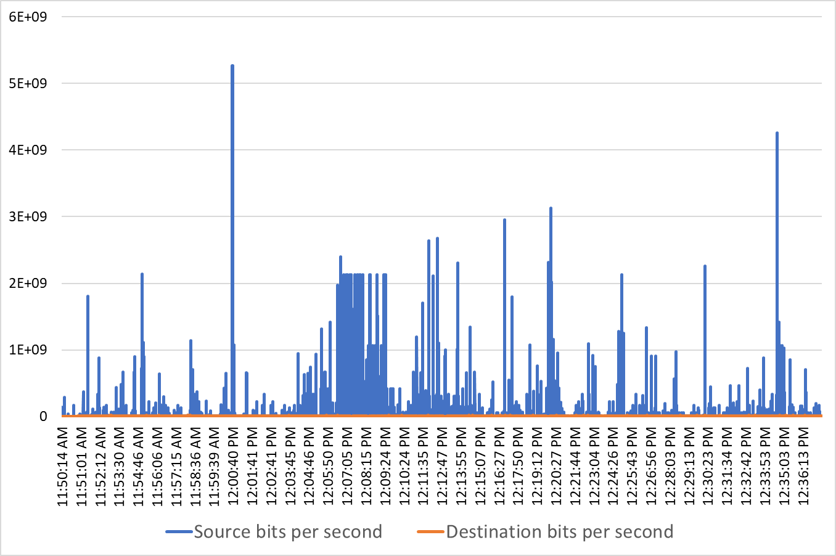
Data Visualization-Sload and dload
Sload and dload contains float values.
Sload stands for Source bits per second whereas dload stands for Destination bits per second.
X-axis represents time of the request.
Y-Axis represents Number of bits per second.
Sload and dload is visualized using line chart.
Number of bits per second
Time

Slide 17
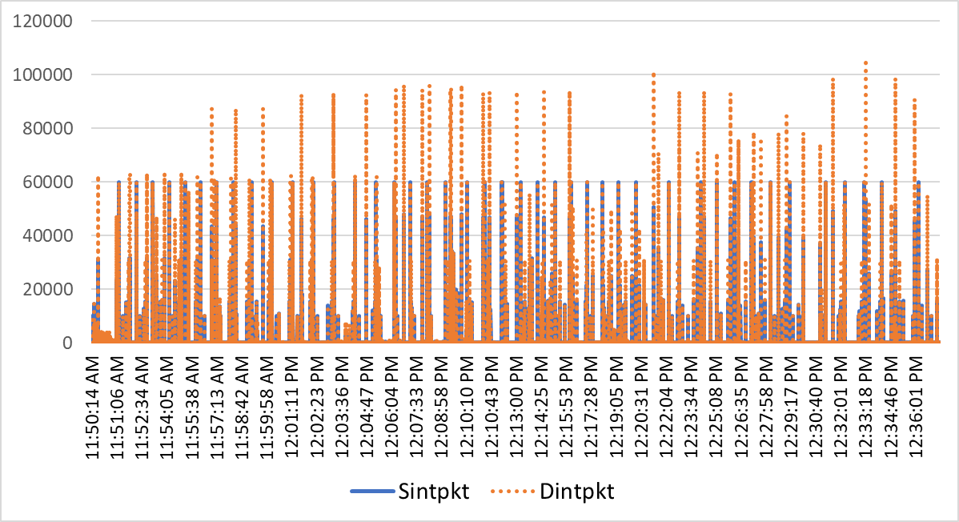
Data Visualization-Sintpkt and dintpkt
Sintpkt and dintpkt feaures contains float values.
Sintpkt is Source interpacket arrival time (mSec) whereas dintpkt is Destination interpacket arrival time (mSec).
X-axis represents time of the event request.
Y-Axis represents interpacket arrival time (mSec).
interpacket arrival time (mSec)
Time

Slide 18
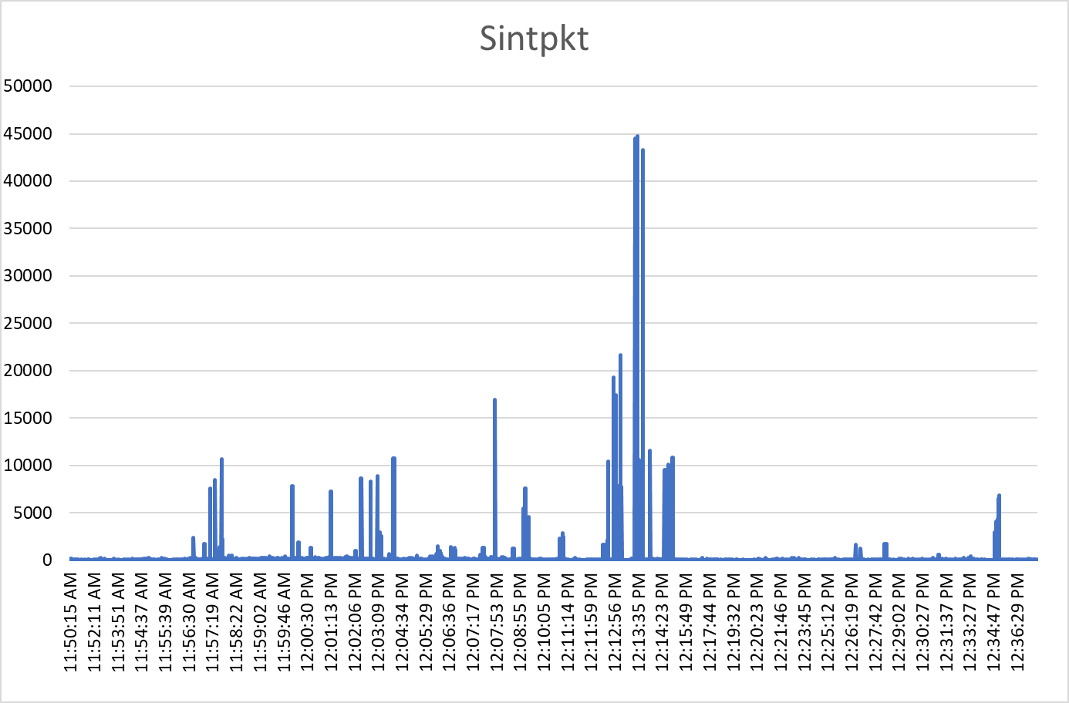
Data Visualization-Abnormal Spkts
Primary Y-axis represents abnormal Source to destination packet count.
X-axis represents time on which the events occurred.
Source to destination packet count
Time

Slide 19
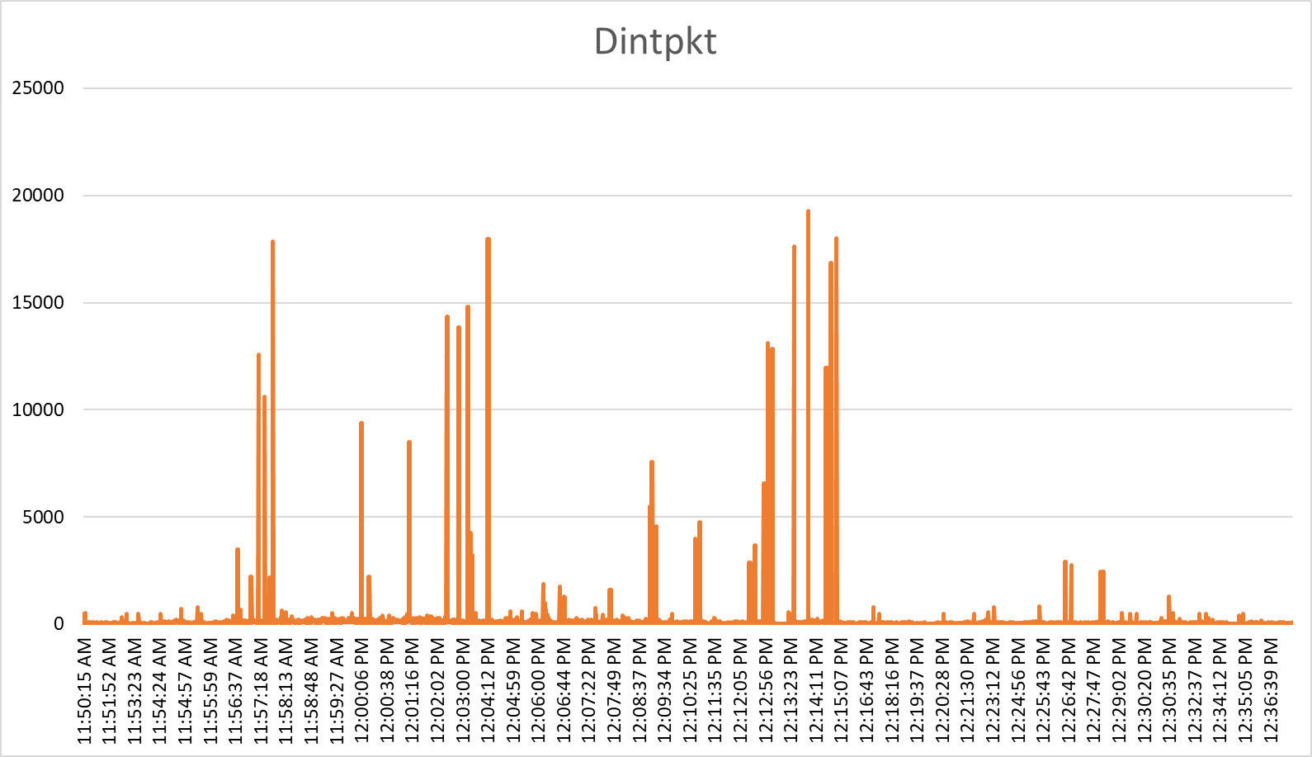
Data Visualization-Abnormal Dpkts
Primary Y-axis represents abnormal Destination to source packet count.
Secondary Y-axis represents abnormal Source to destination packet count.
X-axis represents time on which the events occurred.
Destination to source packet count
Time

Slide 20
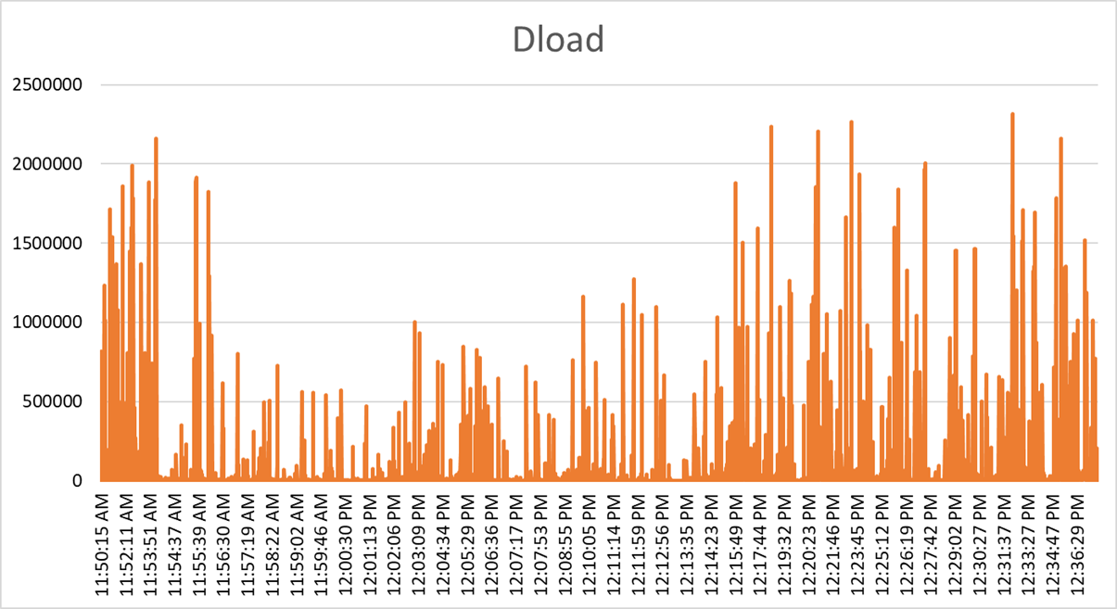
Data Visualization-Abnormal Dload Feature
Primary Y-axis represents abnormal destination bits per second.
X-axis represents time on which the event is occurred.
Destination bits per second
Time

Slide 21
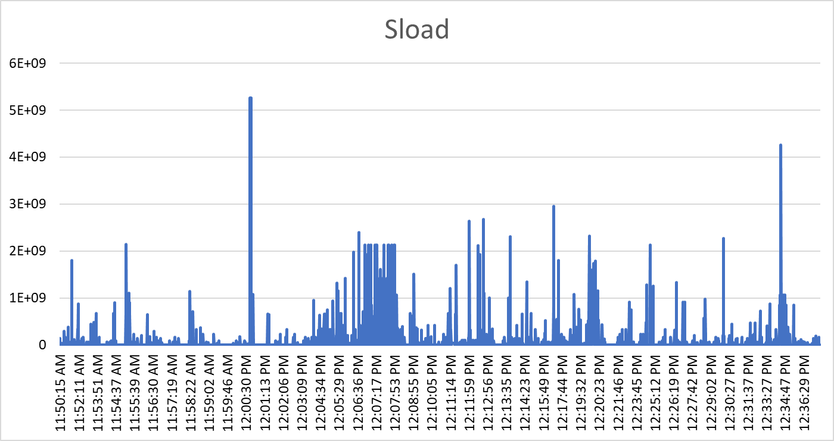
Data Visualization-Abnormal Sload Feature
Primary Y-axis represents abnormal Source bits per second.
X-axis represents time on which the events occurred.
Source bits per second
Time

Slide 22
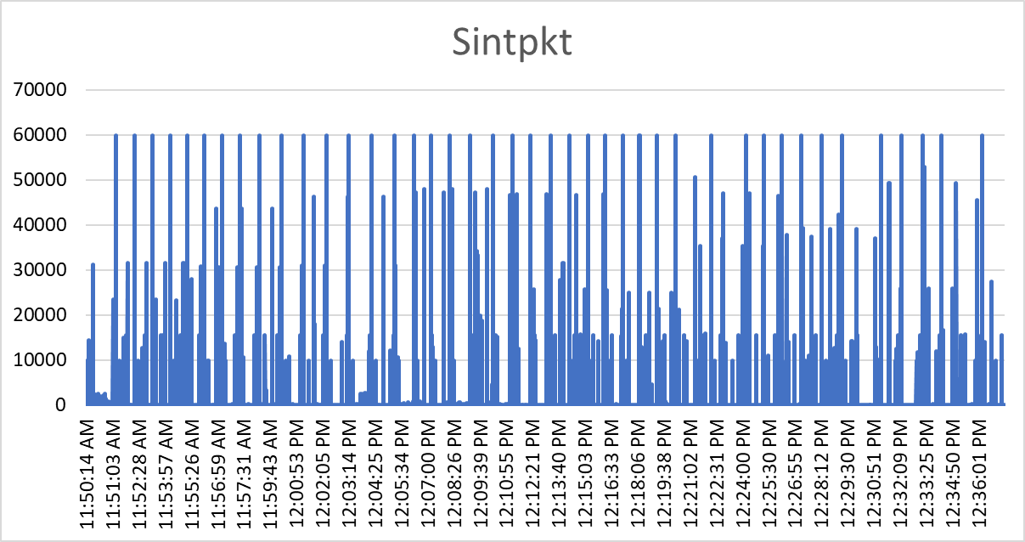
Data Visualization-Abnormal Sintpkt Feature
Primary Y-axis represents abnormal Source interpacket arrival time (mSec).
X-axis represents time on which the events occurred.
Source interpacket arrival time (mSec)
Time

Slide 23
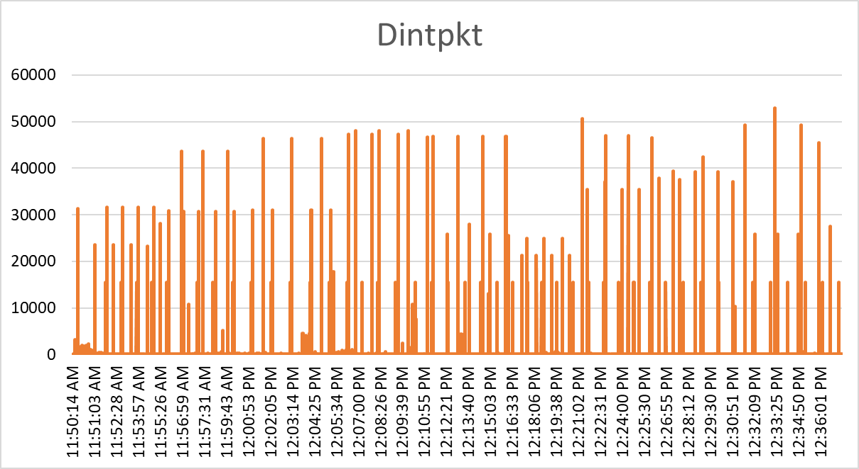
Data Visualization-Abnormal Dintpkt Feature
Primary Y-axis represents abnormal destination interpacket arrival time (mSec).
X-axis represents time on which the events occurred.
Destination interpacket arrival time (mSec)
Time

Slide 24
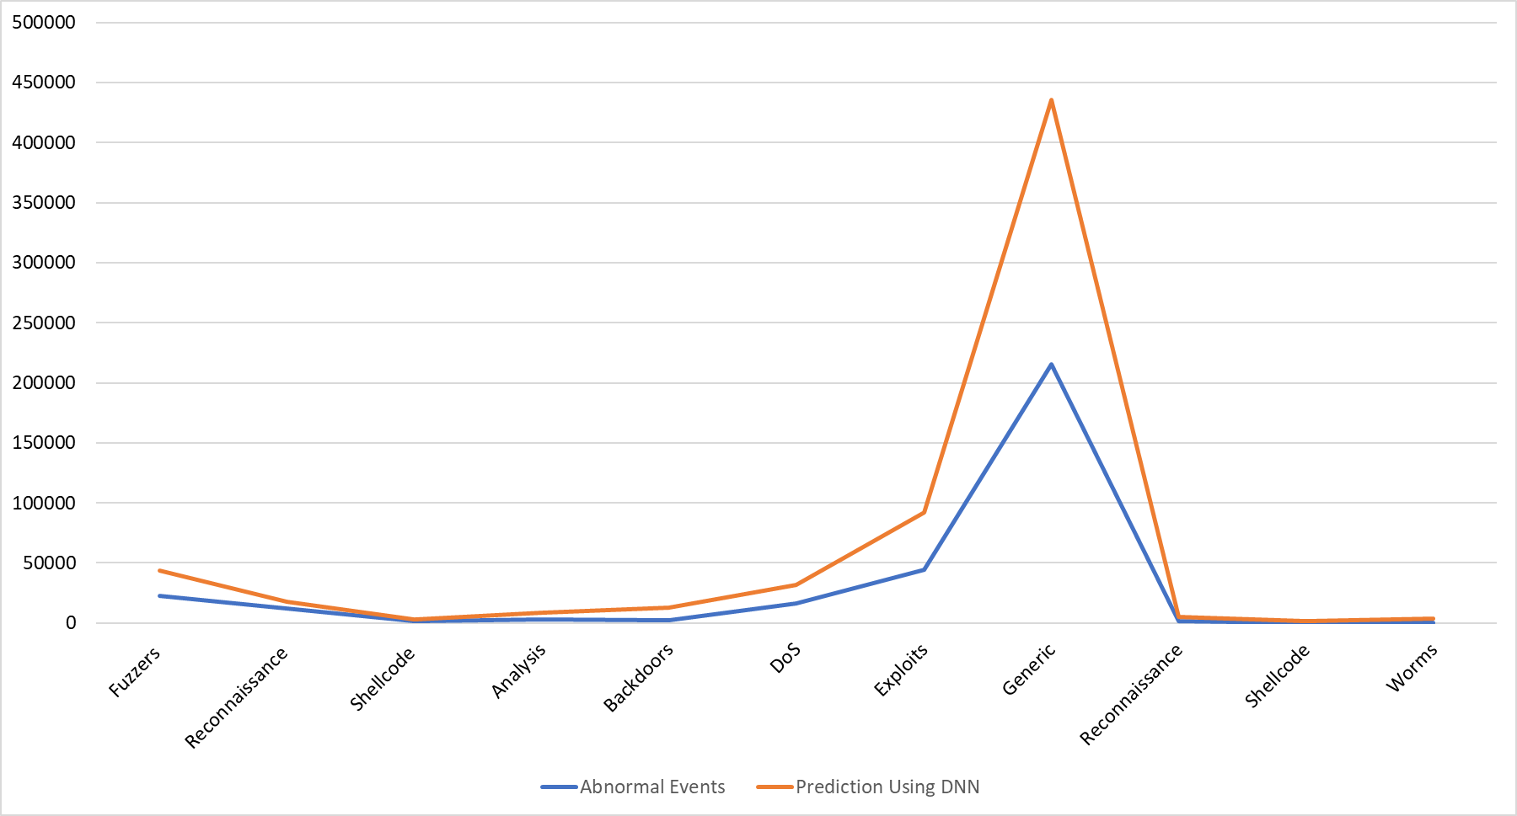
Anomaly type prediction
X-axis represents abnormal events
Y access represents how many time an abnormal event occurred.
The events are predicted using DNN .
The name of each abnormal event Fuzzers, Analysis, Backdoors, DoS Exploits, Generic, Reconnaissance, Shellcode ,Worms.
Events Prediction
Abnormal Events

Slide 25
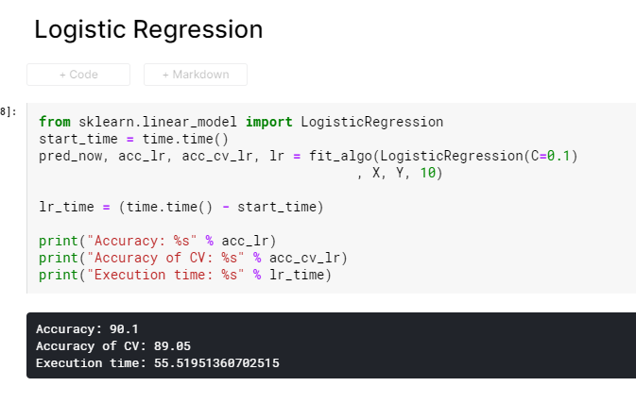
Logistic Regression
Logistic Regression was used in the biological sciences in early twentieth century. It was then used in many social science applications.
Logistic Regression is used when the dependent variable(target) is categorical.

Slide 26
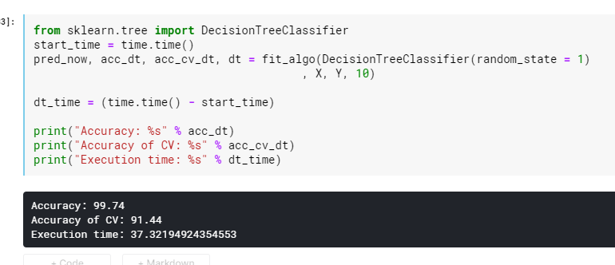
Decision Tree
Decision Tree is a supervised, non parametric machine learning algorithm.
Used for both classification as well as regression problems.
Decision on how to split heavily impacts accuracy of decision tree.
It splits nodes based on available input variables.
Selects the input variable resulting in best homogenous dataset.

Slide 27
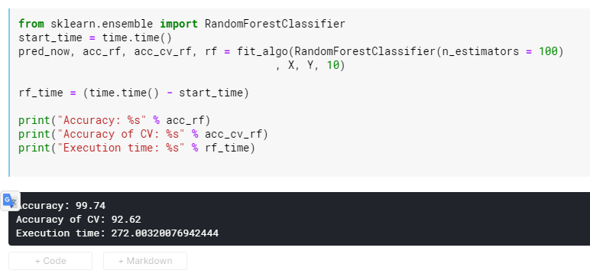
Random Forest (Gini)
An ensemble learning model aggregates multiple machine learning models to give a better performance.
In random forest we use multiple random decision trees for a better accuracy.
Random Forest is a ensemble bagging algorithm to achieve low prediction error.
It reduces the variance of the individual decision trees by randomly selecting trees and then either average them or picking the class that gets the most vote.
Gini Index is a measure of node purity or impurity. It is a measure of how often a randomly chosen variable will be misclassified.

Slide 28
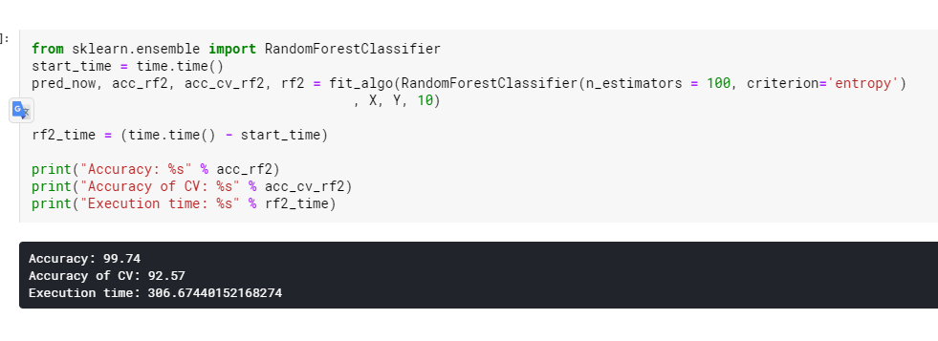
Random Forest (Information Gain)
An ensemble learning model aggregates multiple machine learning models to give a better performance.
In random forest we use multiple random decision trees for a better accuracy.
Random Forest is a ensemble bagging algorithm to achieve low prediction error.
It reduces the variance of the individual decision trees by randomly selecting trees and then either average them or picking the class that gets the most vote.
Information Gain is the difference between uncertainty of the starting node and weighted impurity of the two child nodes. Information gain decides which feature should be used to split the data.

Slide 29
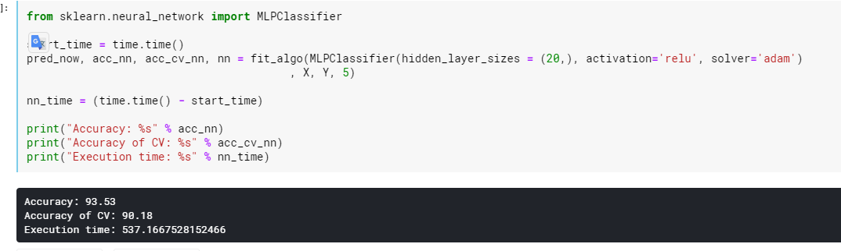
Neural Networks
A neural network is a series of algorithms that endeavors to recognize underlying relationships in a set of data through a process that mimics the way the human brain operates.
In this sense, neural networks refer to systems of neurons, either organic or artificial in nature.

Slide 30
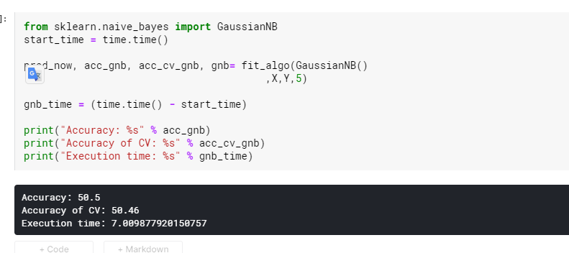
Gaussian Naive Bayes
Naïve Bayes classifiers are highly scalable, requiring a number of parameters linear in the number of variables (features/predictors) in a learning problem.
Maximum-likelihood training can be done by evaluating a closed-form expression which takes linear time, rather than by expensive iterative approximation as used for many other types of classifiers.

Slide 31
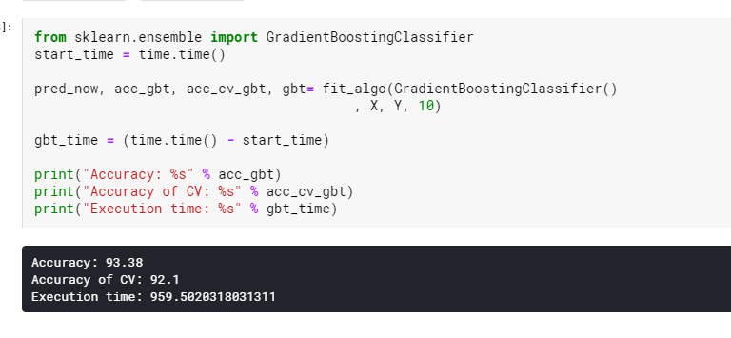
Gradient Boosting
Gradient boosting models are powerful algorithms which can be used for both classification and regression tasks.
Gradient boosting models can perform incredibly well on very complex datasets, but they are also prone to overfitting, which can be combated with several of the methods described above.
Gradient boosting classifiers are also easy to implement in Scikit-Learn.

Slide 32
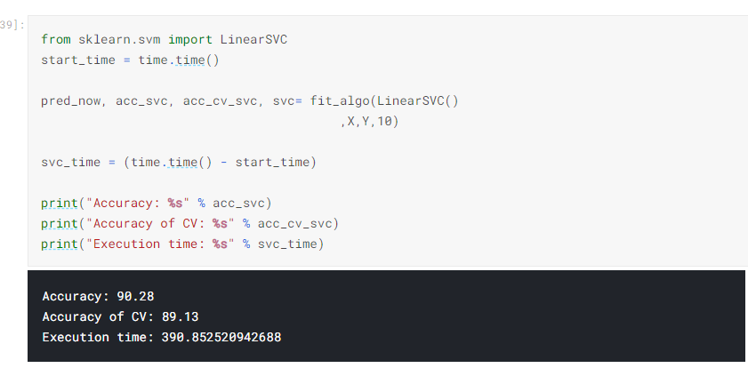
SVM
A support vector machine (SVM) is a supervised machine learning model that uses classification algorithms for two-group classification problems.
After giving an SVM model sets of labeled training data for each category, they're able to categorize new data.

Slide 33
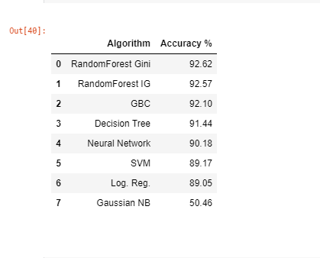
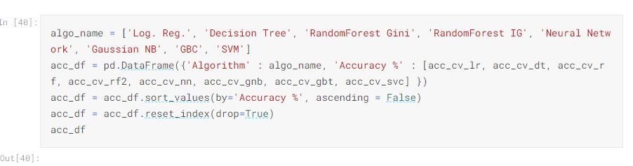
Cross-Validation Accuracy Comparison:
A key challenge with overfitting, and with machine learning in general, is that we can’t know how well our model will perform on new data until we actually test it.
To address this, we can split our initial dataset into separate training and test subsets.
There are different types of Cross Validation Techniques but the overall concept remains the same,
To partition the data into a number of subsets
Hold out a set at a time and train the model on remaining set
Test model on hold out set

Slide 34
conclusion
In this paper, we propose machine learning approaches for anomaly Detection in Network Intrusion Environment.
Models are implemented for Abnormal Detection in Network Intrusion Environment open source dataset.
In the future work, the feature selection part of the model will be further improved, and the model will have a good detection performance on imbalanced datasets.
In the real world, the amount of malware traffic is small compared to the amount of normal traffic, and the proportions of different classes of malware traffic often differ greatly.
The significant improvement in prediction accuracy gives us confidence to further explore the application of the proposed learning to prediction model to improve the performance of other prediction algorithms.

Slide 35
Thanks

